Slide 1
Using SPARK ML pipeline to solve a Machine Learning problem
Name:- Satadru Mukherjee
Roll No:- C22021

Slide 2
Diabetes is a group of conditions where the body cannot produce enough or any insulin, cannot properly use the insulin that is produced, or cannot do a combination of either. When any of these things happen, the body is unable to get sugar from the blood into your cells. This can lead to high blood sugar levels.
Effects of diabetes:
The long-term effects of diabetes include damage to large and small blood vessels, which can lead to heart attack and stroke, and problems with the kidneys, eyes, feet and nerves. The good news is that the risk of long-term effects of diabetes can be reduced.

Slide 3
a machine learning model to accurately predict whether or not the patients in the dataset have diabetes.
Research Objective

Slide 4
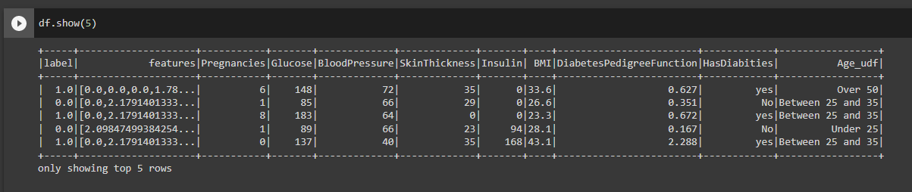
Contextext
This dataset is originally from the National Institute of Diabetes and Digestive and Kidney Diseases. The objective of the dataset is to diagnostically predict whether or not a patient has diabetes, based on certain diagnostic measurements included in the dataset. Several constraints were placed on the selection of these instances from a larger database. In particular, all patients here are females at least 21 years old of Pima Indian heritage.

Slide 5
Content
The datasets consist of several medical predictor variables and one target variable, Outcome. Predictor variables include the number of pregnancies the patient has had, their BMI, insulin level, age, and so on.
Pregnancies: Number of times pregnant
Glucose: Plasma glucose concentration a 2 hours in an oral glucose tolerance test
BloodPressure: Diastolic blood pressure (mm Hg)
SkinThickness: Triceps skinfold thickness (mm)
Insulin: 2-Hour serum insulin (mu U/ml)
BMI: Body mass index (weight in kg/(height in m)²)
DiabetesPedigreeFunction : Diabetes pedigree function
Age: Age (years)
Outcome: Class variable (0 or 1) 268 of 768 is 1, the others are 0

Slide 6
Procedure useD for creating the model

Slide 7
DATA Extraction from GitHub
Wget is a networking command-line tool that lets you download files and interact with REST APIs. Its a URL network downloader that can work in the background, and it helps in downloading files directly from the main server.

Slide 8

Converting the Data Frame into a dictionary.
o_dict() method is used to convert a data frame into a dictionary of series or list like data type depending on orient parameter.
Parameters: orient: String value, ('dict', 'list', 'series', 'split', 'records', 'index') Defines which dtype to convert Columns(series into).
The type of the key-value pairs can be customized with the parameters.

Slide 9
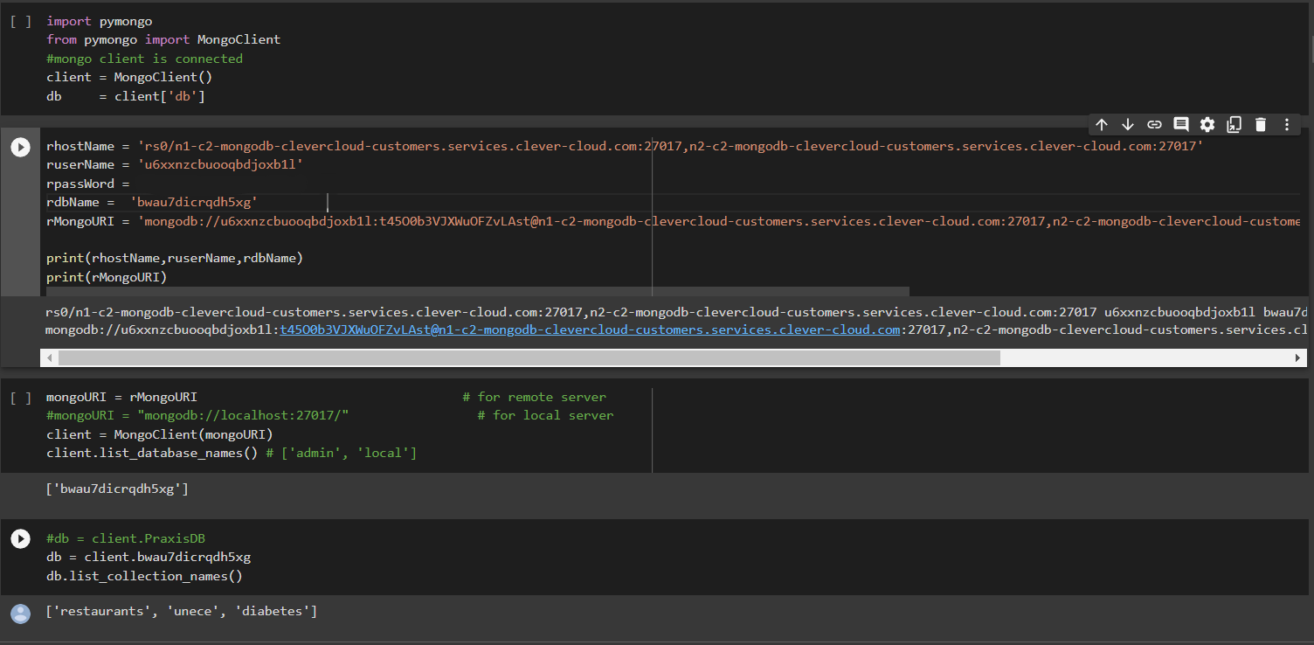
Uploading the data in mongodB using clever cloud

Slide 10
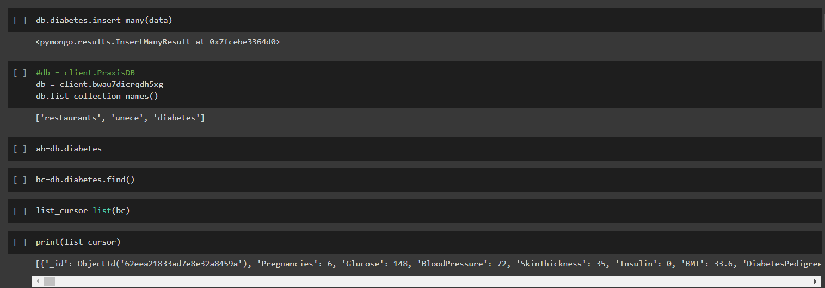
Inserting the data in mongodb

Slide 11
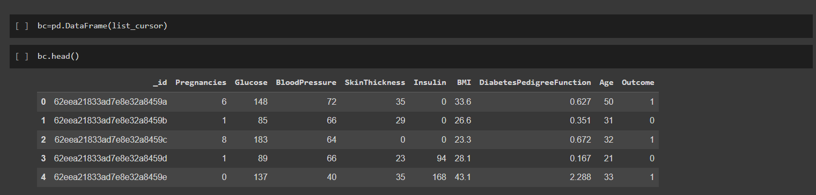
Converting the data into pandas dataframe
It creates a Data Frame object from a structured ndarray, sequence of tuples or dicts, or Data Frame.

Slide 12
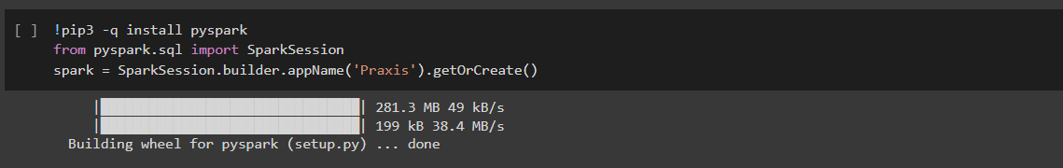
Installation of PySpark
pip3 is the official package manager and pip command for Python 3. It enables the installation and management of third-party software packages with features and functionality not found in the Python standard library. Pip3 installs packages from PyPI (Python Package Index).
PySpark is the Python API for Apache Spark, an open source, distributed computing framework and set of libraries for real-time, large-scale data processing.

Slide 13
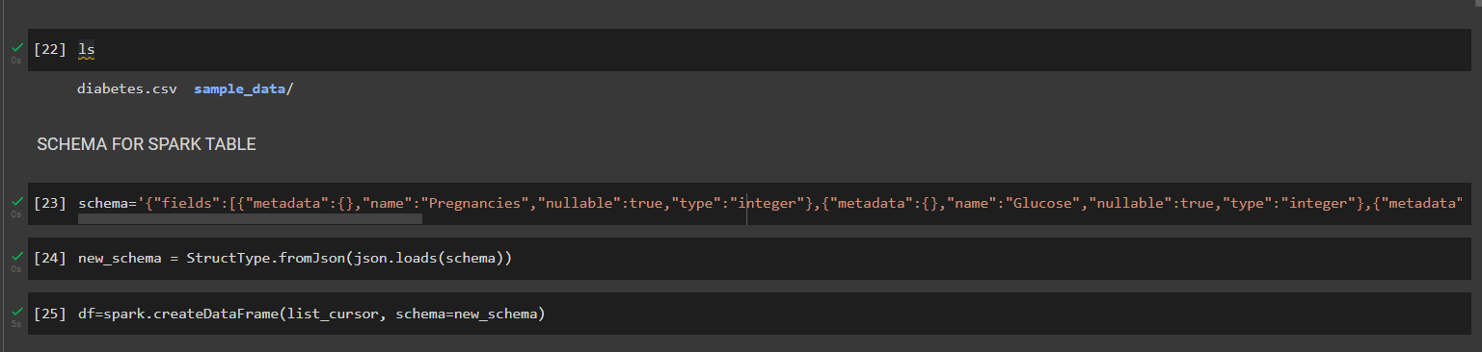
CONVERTINg MONGODB Data inTO spark DATAFRAME
LS (List) command is used to display the files and directories in HDFS, This list command shows the list of files and directories with permissions, user, group, size, and other details.

Slide 14
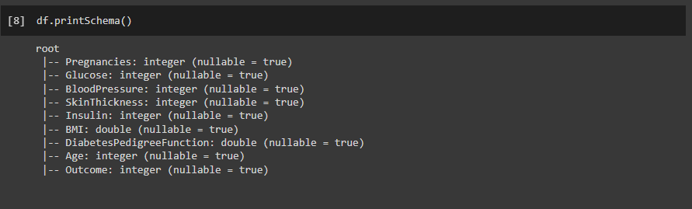
Data Exploration
The printSchema() function on this dataset is used to see the data types of the columns in the table.

Slide 15
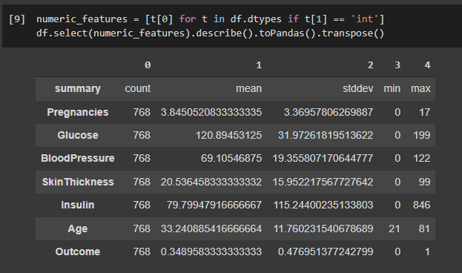
Statistics
The describe() function is used to extract the statistics of the numerical columns in the table.

Slide 16
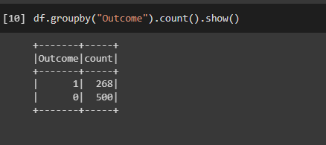
Target Variable Distribution
Our target variable is “Outcome” but this classification dataset does not have equal number of instances in each class, but this difference is trivial for now.

Slide 17
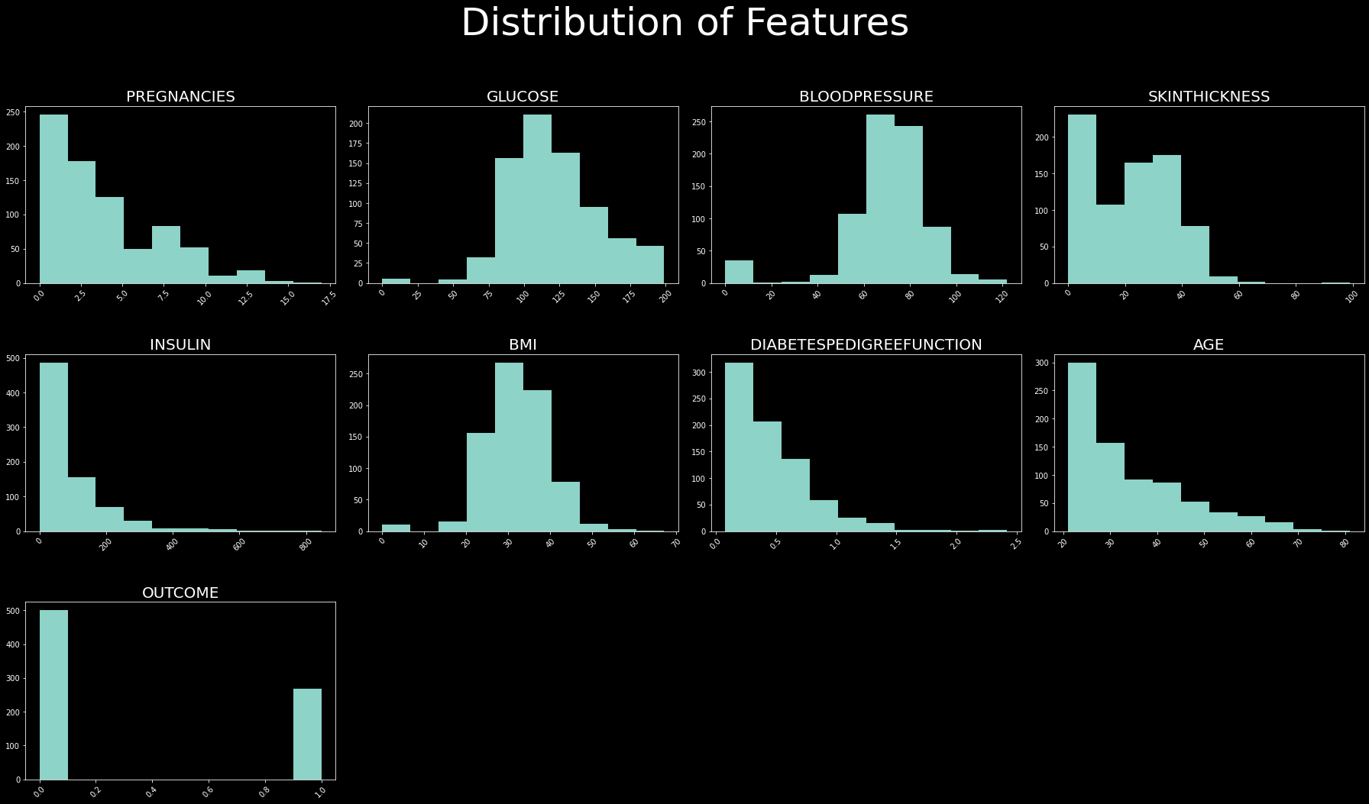
Exploratory Data Analysis

Slide 18
Feature Engineering
User Defined Functions (UDF)
We may want to make various transformations in our data. A User defined function(UDF) is a function provided by the user at times where built-in functions are not capable of doing the required work. We can use our UDFs for data manipulation.
a) Changing Column Name and Converting the Target Variable (Outcome)
We want to change the “Outcome” values from 0 to “No”, and from 1 to “Yes”. We’ll use y_udf to change the name and the values of the target variable
Now, the data type of this column became “String”
b) Create a new column — Age Groups
Our objective is to create groups according to age ranges with the udf_multiple UDF.

Slide 19
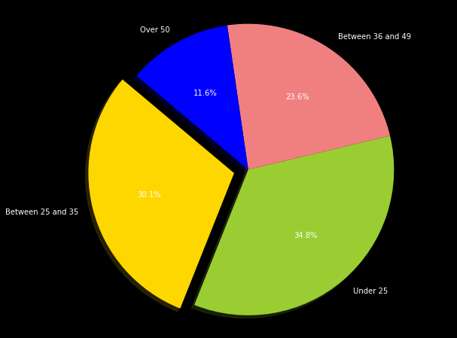
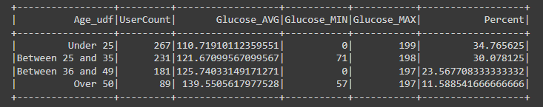
Window Function - Age Groups Distribution
We can use the “groupBy” and “Window” functions to see the Glucose distribution by age group. The Window allows us to see the percentage of each age group in the total dataset.

Slide 20
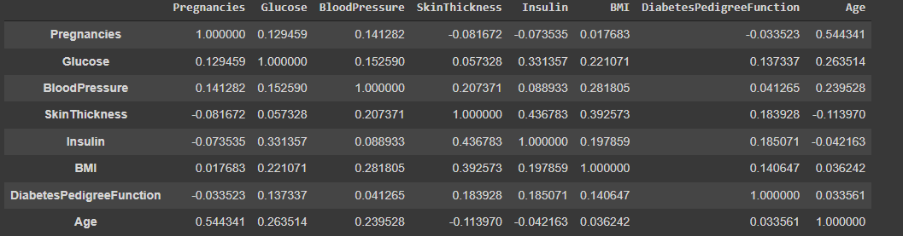
Pearson Correlation
We can use the PySpark statistics library to determine if there is a high correlation between our data. First of all, we determine the numerical columns and make a list of them into the “df_corr” dataframe
We checked whether there is a “pearson” correlation between numerical variables. We can see, the highest correlation is 0.54 and between Pregnancies and Age followed by 0.43 between Insulin and Skin Thickness. It’s obvious that there aren’t highly correlated numeric variables. Therefore, we decide to keep all of them.

Slide 21
Getting THE DATA Ready for Modelling
Firstly, we should apply 5 important transformers/estimators from the pyspark.ml library before we start to build the model.
After applying them, the data will be ready for model building.
StringIndexer
OneHotEncoder
VectorAssembler
LabelIndexer
StandardScaler

Slide 22
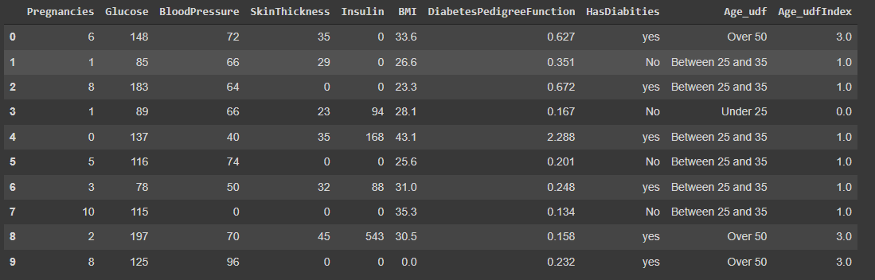
String Indexer
StringIndexer converts a single column to an index column. It simply replaces each category with a number. The most frequent values gets the first index value(0.0). As we see below, “Under 25” has taken 0.0 index value. “Over 50” group has the least population in our dataset. It takes the biggest index value.

Slide 23
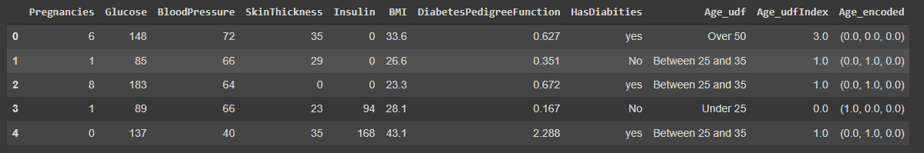
One Hot Encoder
“OneHotEncoderEstimator” is used to convert categorical variables into binary SparseVectors.
With OneHotEncoder, we create a dummy variable for each value in categorical columns and give it a value 1 or 0. This method produces different results with pandas. If we made this transform on Pandas, 4 new columns would be produced for four groups. However, 3 columns are produced on Spark. If our age group is “Over 50”, then Age_encoded will be (0.0,0.0,0.0)

Slide 24
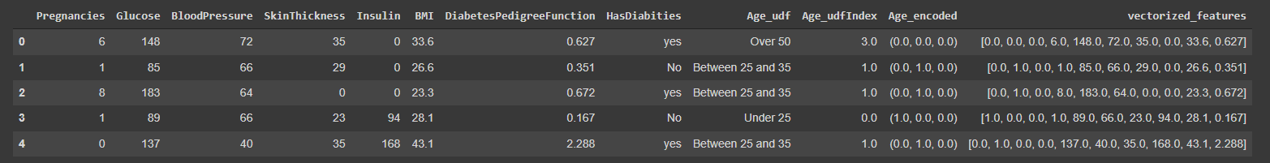
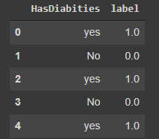
Vector Assembler
All features are transformed into a vector using VectorAssembler.
Convert label into label indices using the StringIndexer.
“No” has been assigned with the value “0.0”, “yes ”is assigned with the value “1.0”.
Label Indexer

Slide 25
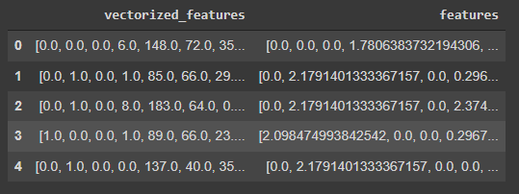
Standard Scaler
Standardization of a dataset is a common requirement for many machine learning estimators: they might behave badly if the individual features do not look like more or less normally distributed data (e.g. Gaussian with 0 mean and unit variance).
StandardScaler is used to standardize features by removing the mean and scaling to unit variance.

Slide 26
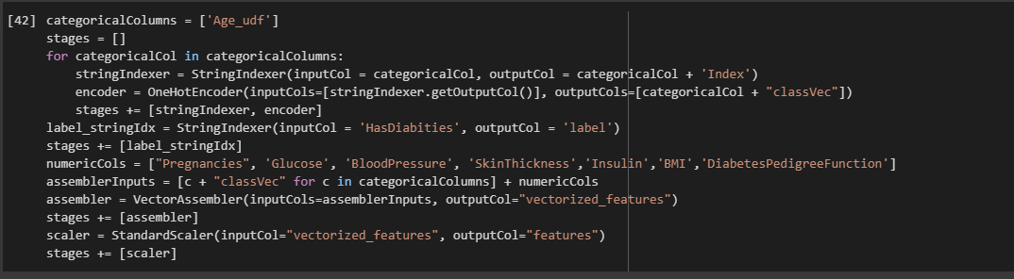
Model Pipeline
We use pipeline to chain multiple Transformers and Estimators together to specify our machine learning workflow. A Pipeline’s stages are specified as an ordered array.
An Easier Way To Build Pipeline
First of all we determine categorical columns. Then, it indexes each categorical column using the StringIndexer. After that, it converts the indexed categories into one-hot encoded variables. The resulting output has the binary vectors appended to the end of each row. We use the StringIndexer again to encode our labels to label indices. Next, we use the VectorAssembler to combine all the feature columns into a single vector column. As a final step, we use StandardScaler to distribute our features normally.

Slide 27
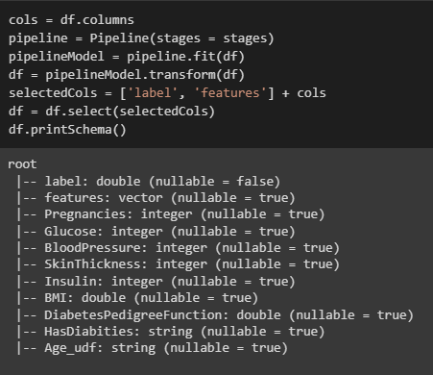
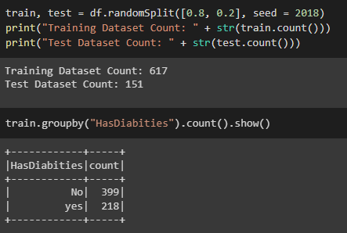
Run the stages as a Pipeline. This puts the data through all of the feature transformations we described in a single call.
Train / Test Split

Slide 28
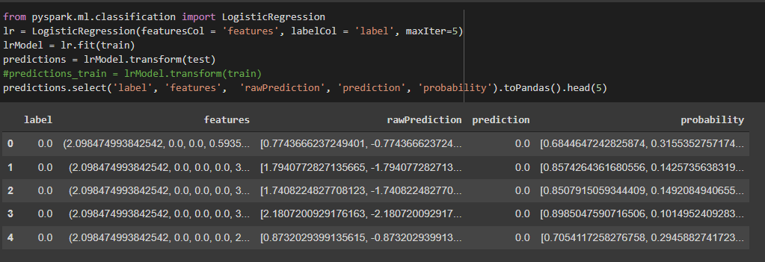
Model Training
Logistic Regression:- It is used in statistical software to understand the relationship between the dependent variable and one or more independent variables by estimating probabilities using a logistic regression equation. This type of analysis can help you predict the likelihood of an event happening or a choice being made.

Slide 29
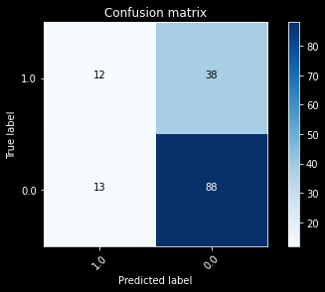
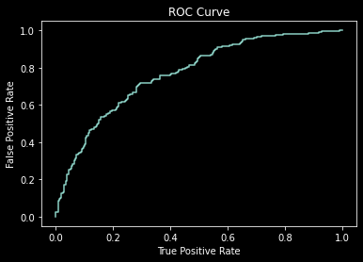
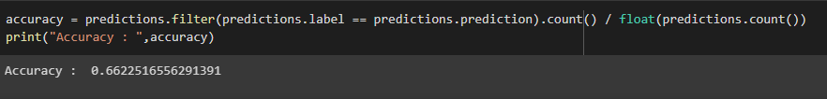
Model Evaluation
Confusion Matrix
ROC is a probability curve and AUC represents degree or measure of separability. ROC tells how much model is capable of distinguishing between classes. Higher the AUC, better the model is at distinguishing between patients with diabetes and no diabetes.

Slide 30
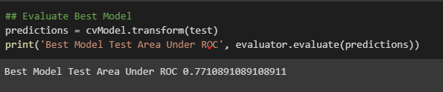
Best Model Performance
Cross Validation and Parameter Tuning
We are trying to tune the model with the ParamGridBuilder and the CrossValidator.
As 3 values are indicated for regParam (Regularization Parameter), 3 values for maxIter (Number of iterations), and 2 values for elasticNetParam (Elastic Net Parameter ), this grid will have 3 x 3 x 3 = 27 parameter settings for CrossValidator to choose from. Let’s create a 5-fold cross validator.

Slide 31
THANK YOU

